Slide 1
Lecture 11 Perceptron
Abrar Hasan
Lecturer
Dept. of Software Engineering

Slide 2
1
Perceptron
<
T
1
>

Slide 3
Perceptron
<
T
1
>
The Perceptron is the simplest form of a neural network model, serving as a binary linear classifier. It's designed to separate data into two classes by finding a hyperplane (a line in 2D, plane in 3D, etc.) that divides the data.

Slide 4

Perceptron
<
T
1
>
b
w1
x1
x2
w2
x3
w3

Slide 5
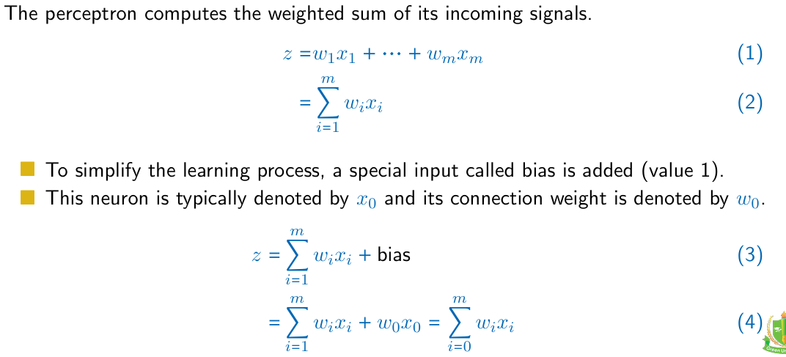
Perceptron
<
T
1
>

Slide 6
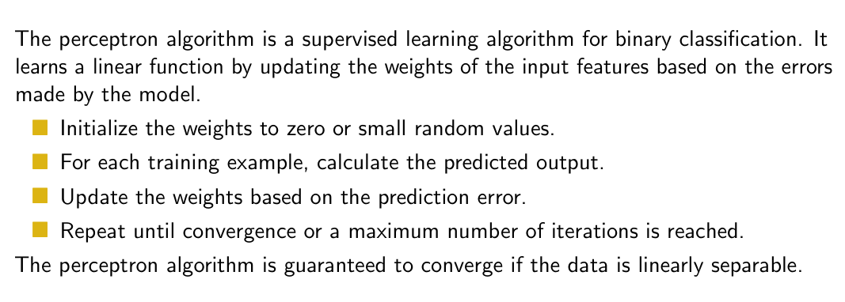
Perceptron
<
T
1
>

Slide 7
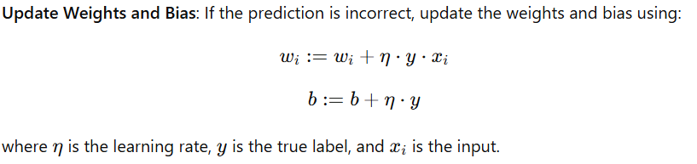
Perceptron
<
T
1
>

Slide 8
Perceptron
<
T
1
>
X1 | X2 | Output
1 | 1 | 1
-1 | 1 | -1
1 | -1 | -1
-1 | -1 | -1

Slide 9

Perceptron
<
T
1
>
W1 = w2= b=0
b
X1 | X2 | Output
1 | 1 | 1
-1 | 1 | -1
1 | -1 | -1
-1 | -1 | -1
w1
x1
w2
x2

Slide 10
Perceptron
<
T
1
>
W1 = w2= b=0
b=0
X1 | X2 | Output
1 | 1 | 1
-1 | 1 | -1
1 | -1 | -1
-1 | -1 | -1
Predicted Value
0
1
W1 =0
W2=0
1
x₁w₁+x₂w₂+b
= 1 * 0+ 1*0+0
=0

Slide 11
Thank You

